Slide 1




How We Care
Member Engagement & Efficiency
BE HUMAN
Emotions Awareness
Call Opening Importance
Call Rhythm Checklist
Members want to maintain their health and take care of their families. This need can sometimes create a mix of member emotions (i.e., anxiety, frustration, urgency & confusion).
After saying hello, you’ll need to quickly understand a member’s situation. First impressions will make the difference in creating confidence, reassurance and managing emotions.
Every call is unique; establishing a standard mental checklist helps you create consistent memorable experiences. Always stay flexible to pivot your routine depending on the call flow.
I can’t believe this happened
This must be wrong, I need an explanation
I hope this doesn’t take too long
I really don’t want to deal with this today
My last call went horribly; It wasn’t helpful
Please let me get someone friendly
I hope they are knowledgeable on what I need
Be Human, show empathy & compassion
Asking “What can I help you with today?” makes people feel individualized
Probing questions help gather the facts and shows you’re listening
A quick recap confirms you’re on the right track
Saying you can help, puts members at ease
Greet the member with a smile
Authenticate to protect privacy
Determine the reason for the call
Perform a Wellness Check for unspoken needs
Resolve the situation & provide education
Confirm the member was fully cared for
Document the facts throughout the call
Humanize Interactions with Heart
I provide a friendly greeting and offer my help
I ensure the safety and well-being of others

Slide 2



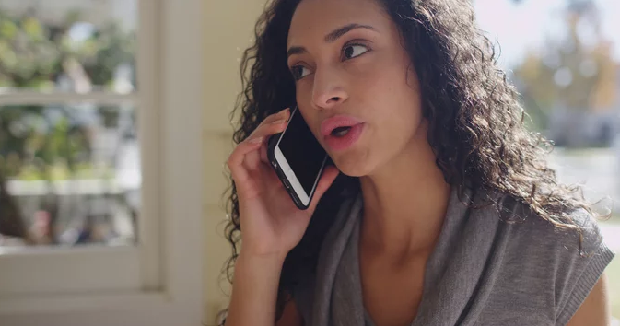
How We Care
Member Engagement & Efficiency
BE HUMAN
Call Handling Tips
Avoid Hold Time
Power of Probing Questions
Call handling success hinges on your ability to understand what’s happening, manage emotions, maintain call control, research, take appropriate actions and to accurately educate.
It’s important to be aware of the negative effects using hold can create for the member and their experiences with us.
The negative effects can include:
As an alternative to using hold or working without speaking, ask probing questions and guide members through the recommended instructions you’re following.
Asking questions & guiding helps you:
Keep in mind, members do not always know what to ask and need your guidance
Ensure full understanding of the ask
Identify the reasons for the call
Maintain focus when conducting research
Avoid members controlling the call flow
Ask questions to drive/regain call control
Use plain language & anticipate questions
Confidence to successfully handle their situation
Situational knowledge uncertainty
Frustration tied to extending the call
Using hold multiple times compounds emotions
Keep the conversation flowing
Gather situational specifics & facts
Show you’re listening and on the right track
Create clear understanding
Steer the focus from a problem to solutioning
Set the stage for a more streamlined closing
DO NOT use hold time to research an account or theSource
Put People First & Act with Accountability
Rise to the Challenge & Inspire Trust
I listen and make sure I understand before I act

Slide 3



How We Care
Member Engagement & Efficiency
BE HUMAN
Hold Time Tips
Call Documentation
Why Being Human Matters
When using hold, time flies very quickly. It’s very important to not forget a few minutes feels like a very long time to members.
Documentation tells a member’s story. It’s a history of all calls made on their behalf. It’s critical to be efficient and mindful when documenting, so it’s done seamlessly as part of your call flow.
It’s important to not treat members as transactions.
Instead, we should focus on the experience we create for them and making it memorable.
Advise to ensure information accuracy, you will need to place the member on a brief hold
Ask to check back in (x) min. unless they want sooner
Care is 5 mins & NEJE is 2 mins
Stay aware how long they’ve been on hold
Refresh every (x) minutes or as agreed upon
Thank the member for holding upon return
Treat members like humans
Confidence & reassurance is driven by words used
Show empathy, timely and where applicable
Speak using easy to follow language
Meet spoken and unspoken needs
Be accurate; will things play out how you described a week later
Members are ready to hang up after their reason for calling is cared for
It’s important to document calls while you talk
Review system generated notes; DO NOT retype
ONLY type manual notes to fill gaps
DO NOT over document; ONLY capture the facts
Use hold for Senior Assist, to initiate a warm transfer, Clinical reach outs or outbound calls
Refer to the Importance of Documentation Member Moments
Manage Expectations & Join Forces
Create Simplicity & Rise to the Challenge
I create heartfelt, personalized moments

Slide 4
How We Care
Member Engagement & Efficiency
BE HUMAN
Call Handling Resources
Commonly Used Indexes
(Commercial, MED D & Medicaid) Basic Call Handling - Greet, Warm, Cold. Call Hold and Close Call (TSRC-PROD-016401)
Aetna - Basic Call Handling (CMS-PRD1-081161)
FEP Shared - Basic Call Handling (TSRC-PROD-01977)
Universal Care - Consultative Call Flow (CCF) Process
(CMS-PRD1-095822) *
Universal Care - Caller Authentication (CMS-2-004568) *
* Universal Care CCF & Auth training is currently rolling out to Commercial (Commercial, Medicaid, FEP & Aetna) through June
Aetna Commercial Member Care - Most Frequently Used Documents – PeopleSafe (TSRC-PROD-015211)
Aetna Med D - Commonly Used Work Instructions Index (TSRC-PROD-015213)
FEP Shared - Document Index (CMS-PRD1-072950)
(Commercial) Frequently Accessed Documents - (Greatest Number of Views) (CMS-PRD1-089133)
MED D - Commonly Used Work Instructions Index (CMS-PRD1-089595)
PHD - Compass Document Index (TSRC-PROD-050058)
theSource Search Tip
Your document will be found at the top of the search results when you use words in the WI title
When you search using words only found in the WI body, your document will be located lower in the search results

